Slide 1
Introduction to Qualtrics
Sean Freeder
04/05/17
D-Lab, University of California, Berkeley

Slide 2
What We’ll Cover Today
Basics of Qualtrics user interface
Creating simple survey questions
Managing survey flow and randomization
More advanced techniques
Miscellaneous Qualtrics Tips
Stupid human tricks
Prepping data for external analysis

Slide 3
Basics of Qualtrics User Interface:
Look & Feel: Options for what the survey will generally look like to your respondents.
Survey Flow: Extremely useful for managing survey order/randomization/content. More on this later.
Survey Options: Mostly can be ignored. Some useful options for very specific problems.
Tools: A few very useful options (“search-and-replace”, “test survey”, “quotas”) that we’ll cover later.
Preview Survey: Allows you to see what respondents will eventually see. Should be used regularly.
DISTRIBUTIONS: Used to create your survey link
DATA & ANALYSIS: Used to export survey data and to check individual results
REPORTS: Used to quickly check aggregate results of survey without having to download dataset
Notes:
Have students create a new survey and go to the main survey overview page

Slide 4
Basics of Qualtrics User Interface:
Levels of Control in Qualtrics
QUESTION: At minimum, a string of text. More often, text followed by one or more response options.
BLOCK: A collection of any number of questions. Used for grouping related questions together for organization, randomization, or looping.
SURVEY FLOW: A collection of any number of blocks, instructions or metadata. Used to determine what will be presented to your respondents, and in what order it will show up.
Notes:
Have students create two empty questions, then look at block options, then copy block, then click on signal flow and look at the multiple blocks

Slide 5
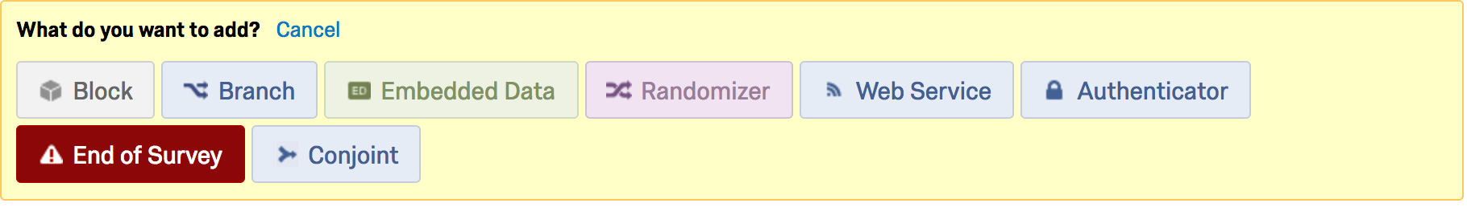
Basics of Qualtrics User Interface:
Types of Building Blocks (Elements) in Qualtrics
BLOCK: A set of survey questions
BRANCH: If/then instructions for displaying other elements
EMBEDDED DATA: Metadata that can be set by the user
RANDOMIZER: Used for randomizing order/display of elements
WEB SERVICE: Accesses APIs – used rarely
AUTHENTICATOR: Allows select respondents survey access – used rarely
END OF SURVEY: Concludes survey upon reaching this element
CONJOINT: Displays conjoint experiment (not covered today)
Notes:
While in survey flow, click "add element"

Slide 6
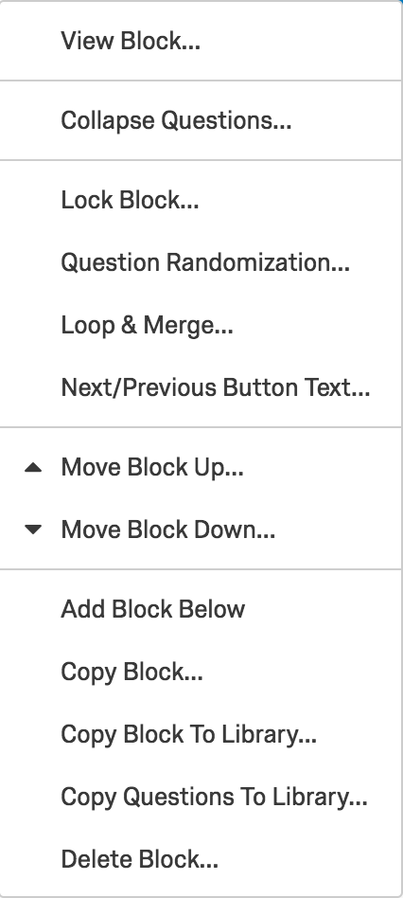
Basics of Qualtrics User Interface:
Particularly Useful Block Options
QUESTION RANDOMIZATION: Allows randomization at the block level
LOOP & MERGE: Allows slightly different versions of the same block to be completely repeatedly
COPY BLOCK: Useful for quick duplication
COPY BLOCK TO…: Useful for saving frequently used content across surveys
Notes:
Click on "block options" and look at the drop down list

Slide 7
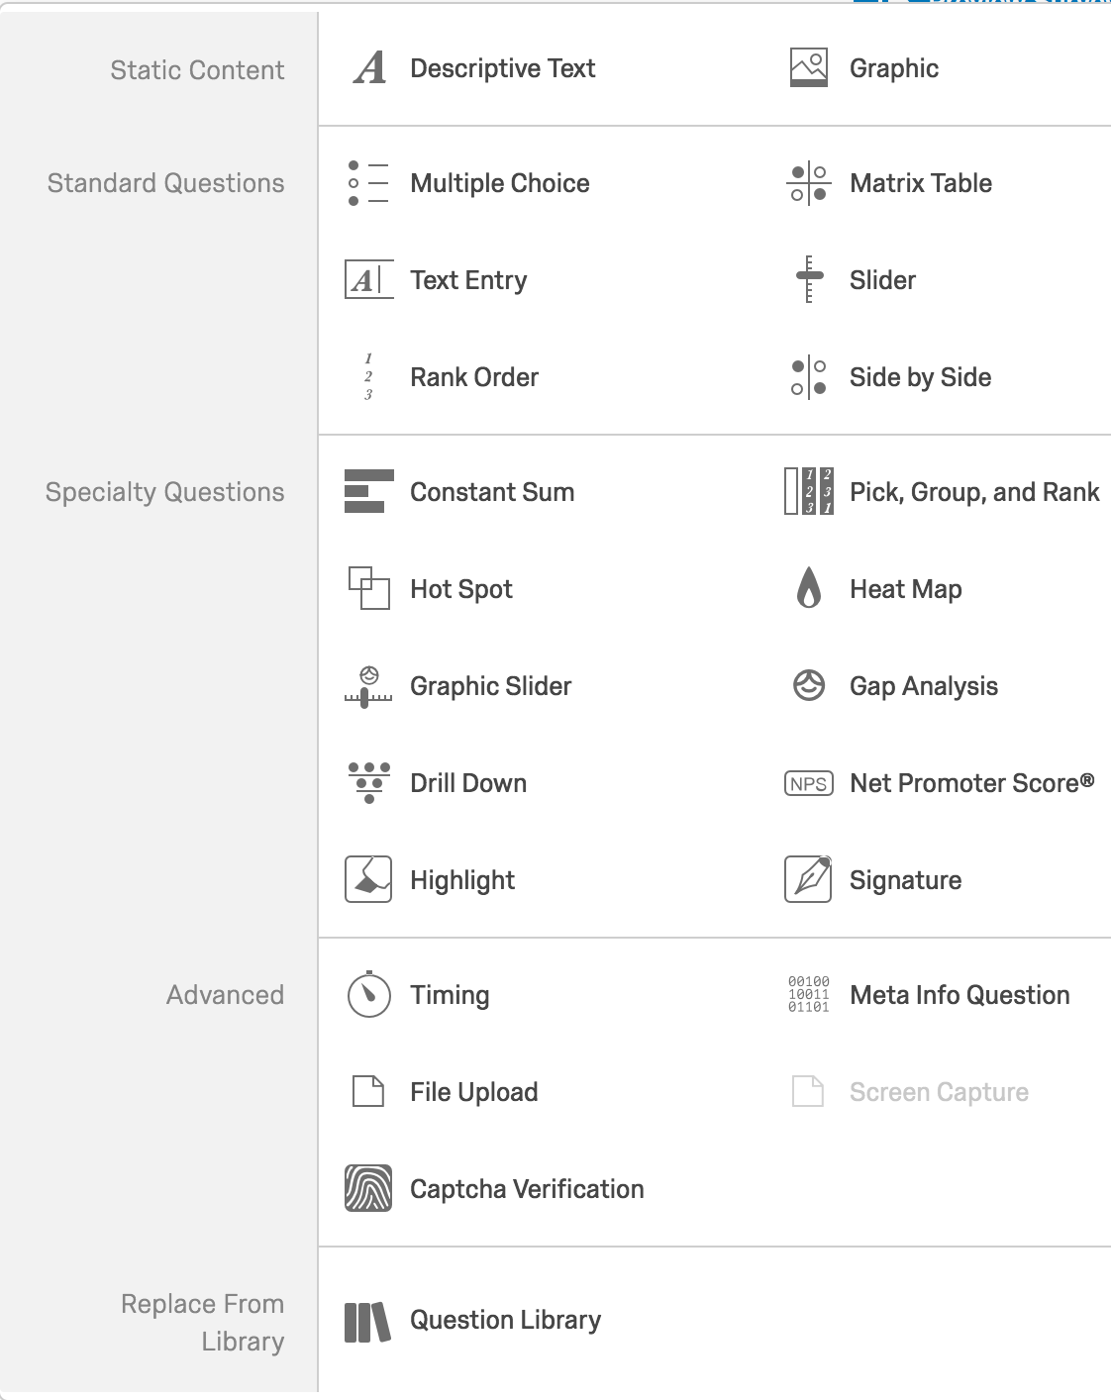
Creating Simple Survey Questions
Types of Questions
Static Content: Useful for instructions and image display
Standard Questions: Almost always use these questions
Specialty Questions: Usually not useful, “Constant Sum” and “Drill Down” good
Advanced: Collecting metadata, “timing” is especially useful
Notes:
Click on the first question and look at the list on the right

Slide 8
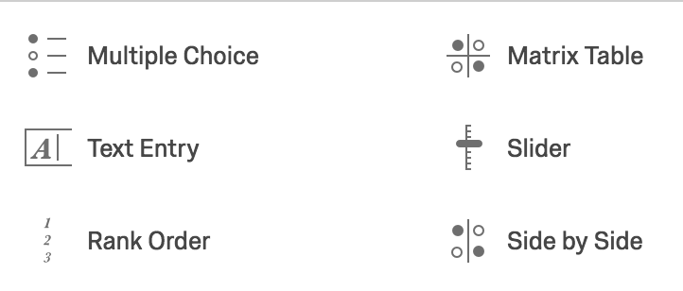
Creating Simple Survey Questions
Basic Question Tips
Multiple Choice: Use “single/multiple”, “vertical/horizontal” options typically
Matrix Table: For rating multiple things simultaneously. Use “likert”. “Bipolar” sometimes even useful for single answers.
Text Entry: Multiline, increase box size
Slider/Rank Order: Sometimes useful, but more confusing to respondents. “Rank Order” good for forcing rankings
Notes:
Same; have them create a 5x5 matrix table

Slide 9
Creating Simple Survey Questions
Question Options (located on the right)
Validation Options: Used to make sure respondents actually answer your questions
FORCE: Question must be answered. Use on questions that survey flow relies on for logic.
REQUEST: Reminds subjects to answer questions. Use on all other questions.
Add Page Break: Used to separate questions from one another on the actual survey
Use liberally!
Randomization can mess up page breaks
Notes:
Same

Slide 10
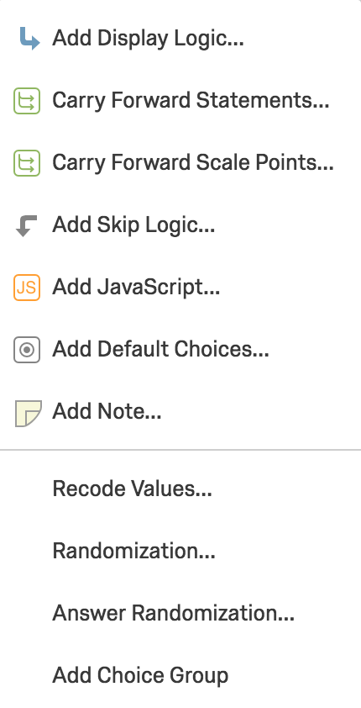
Creating Simple Survey Questions
Question Options (located in the “gear”)
Add Display/Skip Logic: Extremely useful for managing survey flow
Carry Forward: Takes previously used options and displays them again
Add Javascript: Advanced, but very useful
Randomization: Change the order of options
Recode Values: Change output value/variable labels
Notes:
Have them delete one of the options of your 5x5 matrix when they get to the recode values step

Slide 11
Managing Survey Flow and Randomization
“If/Then” Logic
Display Logic: Controls whether current question is displayed based on previous question answers.
Skip Logic: Controls whether next question(s) are displayed based on current question answers.
Branch (in ”Survey Flow”): Controls whether a block is displayed based on previous question answers.
Notes:
Have them import questions from Question Library --> party and sex

Slide 12
Managing Survey Flow and Randomization
Randomization Options
Randomization: Randomizes the order/appearance of response/item options (under “gearbox”)
Answer Randomization: Randomizes the order/appearance of scale options (under “gearbox”, sometimes)
Question Randomization: Randomizes the order/appearance of questions (under “block options”)
Randomizer: Randomizes the order/appearance of survey elements (under “survey flow”)

Slide 13
Managing Survey Flow and Randomization
Randomization Techniques
Question/Answer Randomization
Randomize Order, All: Presents all options in a random order
Present Only…: Chooses N options from Y in a random order
Advanced: Allows you to apply the above randomizations to only a select subset of the options
WARNING: Advanced randomization at the block level will disturb existing page breaks. If you use this AND need page breaks, you can set the number of questions allowed (usually 1) at the bottom of the Advanced Randomization panel.

Slide 14
Managing Survey Flow and Randomization
Randomization Techniques, Continued
Block Randomizer: Will present N of the Y blocks listed below in the signal flow
Evenly Present Elements: Determines randomization technique for whether a given block shows up
Selected: Each new respondent will be shown the block after the one displayed to the previous respondent
Not Selected: Any given block has probability P of showing
Selecting will guarantee equal numbers of people see each condition, not selecting will create expectation of equality

Slide 15
Managing Survey Flow and Randomization
Elements of Signal Flow: Embedded Data
Embedded Data will attach a variable with a given value to any respondent who encounters it in the survey flow
Embedding ”Set Values”: Name the variable anything, then set the value to a desired number or text
Embedding “URL Values”: Name the variable after the URL field you want to collect
Uses of embedded data: Creating treatment/control groups, capturing IDs for repeat use of respondents in panel studies, setting up complex if/then logic chains

Slide 16
Managing Survey Flow and Randomization
Elements of Signal Flow: End of Survey
When a respondent encounters an End of Survey element, they will be shown a customizable message, and the survey will end.
Surveys can have multiple End of Survey elements in them, triggered by different conditions, but any given respondent can only hit a single one.
Uses of End of Survey: Providing a redemption code for workers, preventing access to the survey for an unqualified respondent, redirecting respondents to a different survey

Slide 17
More Advanced Techniques
Quotas
Quotas are found under ”Tools”, and used to ensure you only get a certain number of respondents of a certain type
To use a quota, simply select a question that has response options you want to select on, then set the number of people allowed to select that option. When the actual number exceeds the quota, clicking that option will automatically end the survey.
Generally, you want to put quota questions at the beginning of the survey. Otherwise, you’ll have very angry respondents!

Slide 18
More Advanced Techniques
Using Timers
Timers allow you to measure and control how much time is being spent on a given page
Access: Question Options > Advanced > “Timing”
Placing it before a question will tell you how long is spent on a page. Timers record timing for pages, not questions or blocks.
Under the options on the right, you can force people to stay on a given page either up to or no more than a specified length of time.

Slide 19
More Advanced Techniques
Testing Your Survey
You can preview the survey an infinite number of times using the “Preview Survey” button at the top. You can also preview an individual question using “Preview Question” on the right question options panel, and preview a block by select “View Block” from Block Options.
To make sure randomization is working, you can use “Test Survey” to pipe through fake respondents (up to 1000). NOTE: fake respondents will make all answer selections randomly.
Both previews and tests are automatically recorded, and will need to be deleted later before you download the data.

Slide 20
More Advanced Techniques
Piped Text
You can use the interface to pipe in text of all kinds into the text of a question, response options, or scale labels.
Access piped text by clicking either on the question text box and selecting “Piped Text”, or by selecting a response/scale option and selecting “Piped Text” from the dragdown menu.
All piped text appears in the editor as ${x://…/…}, where “x” is equal to…
q: text from previous questions and responses
e: text from embedded data
lm: text from a loop-and-merge

Slide 21
More Advanced Techniques
Loop and Merge
If you want people to answer a large number of very similar questions in a row, Loop And Merge provides an easy way
Access this function by selecting “Loop and Merge” under Block Options
”Loop and Merge” will repeat the entire block while displaying new ”Field Value(s)” for each loop. Type in values as desired, then on the question text, enter ${lm://Field/x}, where “x” corresponds to the field column from the Loop and Merge page.

Slide 22
More Advanced Techniques
Using Javascript
Qualtrics is Javascript-compliant
Most things you want to do in Qualtrics can be done without Javascript, but JS can be used to set up very complicated randomization schemes
To implement, click “add Javascript” from the Gear menu on the first question in your survey. Note that JS will not function until the page after the one it gets implemented on.

Slide 23
Miscellaneous Qualtrics Tips
When setting Display Logic, be very careful of AND versus OR.
Data output for ”multiple answer” questions is annoying.
Use the “Survey Flow” feature to move blocks around.
Try not to copy lots of versions of the same question until you KNOW that is going to be the final version of that question.
Empty the trash regularly to prevent slowdown
Label all questions in advance
HIDE your affiliation with Berkeley! (Look & Feel; shorten survey link w/ bitly.com)

Slide 24
Stupid Human Tricks
Use page breaks as often as makes sense
Think carefully about the order of your questions – demographics often are best last
Always put instructions on a separate page from activities
Use bold, italics, and COLOR thoughtfully for emphasis.
Do as much as you can to hide the purpose of your survey!
Strongly consider using an attention check (or threat of one)
Include a ”comments” section at the very end of the survey
Keep tasks and texts that respondents have to engage in as brief as possible

Slide 25
Prepping Data for External Analysis
Make sure that you have cleared all Preview and Test data before downloading
Select from the “Tools” tab under the “Data & Analysis” header
To download your data:
”Export and Import” > “Export Data”
Choose “Download Data Table”
If you later find that you cannot tell which blocks certain respondents were shown, go back and download the “Legacy Format”, which keeps this info.
Under “Download all fields”, choose “Use numeric values”
This is a personal preference, but it makes working with your data in STATA or R much easier in the long run

Slide 26
Good luck and thank you!

